Slide 1
Software Engineering Methods
Lecturer: Rob Kemmer (C67)
r.kemmer@napier.ac.uk
Topics:
Software Lifecycles: Traditional / Agile
Unified Software Development Process (USDP)
UML

Slide 2
Software Project Failure Rates
Source. CHAOS Study (Standish Group)
http://www.projectsmart.co.uk/docs/chaos-report.pdf but...
http://versionone.com/assets/img/files/ChaosManifesto2013.pdf

Slide 3
Software Lifecycles
An information system has a life cycle of several phases, e.g:
Concept → development → operation → maintenance → replacement
This cycle might take a few years/months/weeks and involve lots of iteration at each phase
Stages of the Traditional Systems Life-cycle
Feasibility Study
Requirements Analysis
System Design
Implementation
Testing
Maintenance

Slide 4
Waterfall Life-cycle
Requirements
Analysis
Design
Implementation
Testing
Maintenance
At each stage problems may be discovered, or new features defined, that require a return to earlier stages in the life-cycle.
This life-cycle has been used successfully for many years

Slide 5
Waterfall SDLC
Seen as a series of stages:
Requirements: Initial idea or proposal, often from user/client
Needs, scope, risk factors
Analysis: what should system do from client/user view?
Set of models of the system
Design: how can system be build to meet requirements?
Analysis models adapted to technology available
Implementation: how can models be translated to code?
A fully tested set of software solutions
Installation: how can clients use new system effectively?
User manual, technical documentation, training, data conversion
Maintenance: after installation software systems are normally subject to continual change as requirements and businesses evolve and also to repair errors (bugs?)

Slide 6
V Model
Requirements Modelling
Acceptance Testing
Architectural Design
System
Testing
Component Design
Integration Testing
Code Generation
Unit
Testing
Executable Software

Slide 7
Problems of traditional life-cycles
developments are rarely sequential
users often do not know what they want
errors in design may not be obvious until very late in the project
is not the best model for modern development tools
addresses technical rather than user needs

Slide 8
Alternative approaches to SD
A number of approaches have been developed over the last 30 years to solve the problems of the ‘waterfall’ model:
Structured methods (SSADM, etc.)
Computer-aided software engineering (CASE)
End-user development (inc. 4GLs)
Application software packages & outsourcing
Prototyping
Rapid applications development (RAD)
Dynamic or Agile methods (XP, Scrum , etc.)
Object-oriented development
The last 2 will form the remainder of the module teaching

Slide 9
Alternative Models
Agile: Scrum, XP, DSDM
Object-orientation and its impact on lifecycles – the Unified Software Development Process (USDP)
Unified Modelling Language (UML)
Use Cases
Activity diagrams
State diagrams
Class diagrams

Slide 10
Definitions
“Agile” refers to a group of software development methodologies based on iterative development, where requirements and solutions evolve through collaboration between self-organizing cross functional teams.
Agile methods are defined in the Agile Manifesto
Agile methods have much in common with the earlier Rapid Application Development (RAD) Modules

Slide 11
Aim of Agile / RAD
High
Speed
High
Quality
Low Cost

Slide 12
Agile Manifesto
“We are uncovering better ways of developing software by doing it and helping others do it.
Through this work we have come to value:
Individuals and interactions over processes and tools
Working software over comprehensive documentation
Customer collaboration over contract negotiation
Responding to change over following a plan
That is, while there is value in the items on the right, we value the items on the left more”

Slide 13
Agile Methodologies
Several “flavours” of Agile Development
Lean Development
Extreme Programming (XP)
Dynamic Systems Development Method (DSDM)
SCRUM
Others: Crystal Clear, Lean Development, Feature Driven Development (FDD) and many others

Slide 14
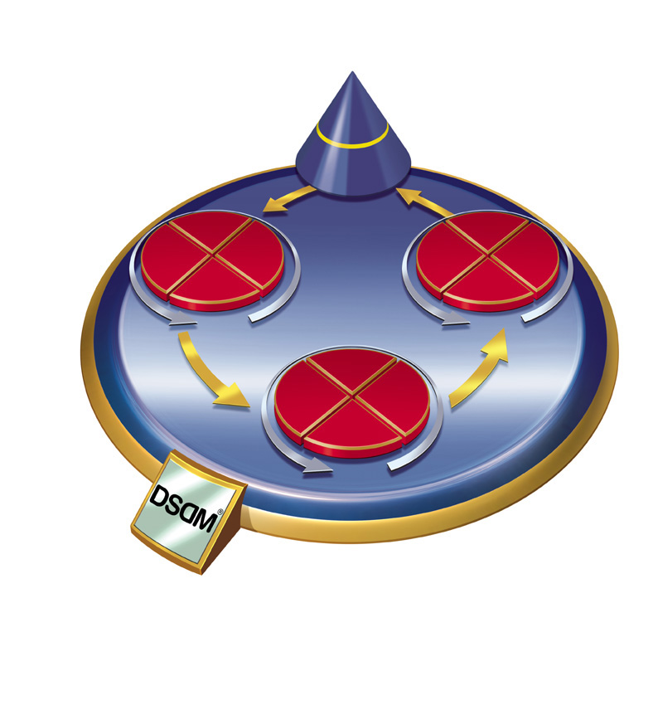
Traditional SD vs Agile
Functionality
Time Resource
Fixed
Traditional
Vary
Time Resource
Functionality
© DSDM

Slide 15
Lean development
Lean development can be summarized by seven principles, very close in concept to lean manufacturing principles:
Eliminate waste
Amplify learning
Decide as late as possible
Deliver as fast as possible
Empower the team
Build integrity in
See the whole

Slide 16
Extreme programming (XP)
http://www.extremeprogramming.org/index.html
Developed by Kent Beck (then software developer for Crysler)
Aim to deliver high-quality software quickly and continuously,
promotes high customer involvement,
rapid feedback loops,
continuous testing,
continuous planning,
close teamwork to deliver working software at very frequent intervals, typically every 1-3 weeks.

Slide 17
Values of XP
Simplicity: We will do what is needed and asked for, but no more.
Communication: Everyone is part of the team and we communicate face to face daily.
Feedback: We will take every iteration commitment seriously by delivering working software. We demonstrate our software early and often then listen carefully and make any changes needed.
Respect: Everyone gives and feels the respect they deserve as a valued team member.
Courage: We will tell the truth about progress and estimates.
Rules: http://www.extremeprogramming.org/rules.html

Slide 18
XP techniques
User stories: XP project begins by having the end users of the software create user stories describing what the new applications need to do.
Team delivers highest priority user stories as working, tested software on an iteration by iteration basis
Testing is central to XP:
All code must have unit tests.
All code must pass all unit tests before it can be released.
When a bug is found tests are created to identify it.
Acceptance tests are run often and the score is published.
"Refactoring”: frequent streamlining of design and improving of code is a core doctrine.
“Pair programming”: programmers work in pairs – 2 to a computer

Slide 19
SCRUM
http://www.scrumalliance.org/pages/what_is_scrum
A “process skeleton,” that contains sets of practices and predefined roles.
Work is structured in cycles of work called sprints, iterations of work that are typically two to four weeks in duration.
During each sprint, teams pull from a prioritized list of customer requirements (user stories). Features developed first are of the highest value to the customer.
At the end of each sprint, a potentially shippable product is delivered.

Slide 20
SCRUM roles
the “Scrum Master”, who maintains the processes
the “Product Owner”, who represents the stakeholders
the “Team”, a cross-functional group of about 7 people who do the actual analysis, design, implementation, testing, etc.

Slide 21
DSDM – an ‘agile’ method
Dynamic Systems Development Method www.dsdm.org
Collaborative & cooperative
Systems fit for business purpose
Reverses basic paradigm for SD
Involves users heavily
Iterative & incremental, not prespecified
Changes basis of client/developer relationship

Slide 22
DSDM
Projects managed/delivered in short, fixed-length chunks called “timeboxes” or “iterations” (typically 1 – 6 weeks)
“a process by which defined objectives are reached at pre-determined and immovable dates through continuous prioritisation and flexing of requirements.” (DSDM)
In each time-box requirements are specified using “MoSCoW” rules:
M – Must have requirements
S – Should have if at all possible
C – Could have but not critical
W - Won’t have this time, but potentially later
Not every requirement in a project or time-box is critical so in each time-box less critical items can be shelved to ensure essential (“M”) targets can be achieved.

Slide 23
Principles of DSDM
Active user involvement is imperative
Teams empowered to make decisions
Focus on frequent delivery of products
Fitness for business purpose is the essential criterion for acceptance of deliverables
All changes during development are reversible
Testing is integrated throughout the life-cycle

Slide 24
Agile project successes
According to the 2010 IT Project Success Survey, our success rates are
Ad-hoc projects: 49% are successful, 37% are challenged, and 14% are failures.
Iterative projects: 61% are successful, 28% are challenged, and 11% are failures.
Agile projects: 60% are successful, 28% are challenged, and 12% are failures.
Traditional projects: 47% are successful, 36% are challenged, and 17% are failures.
http://www.drdobbs.com/architecture-and-design/2010-it-project-success-rates/226500046

Slide 25
